Slide 1
SVG
Creating Vector Graphics in the Web
Telerik Software Academy
Learning & Development
http://academy.telerik.com

Slide 2
Table of Contents
SVG Overview
Vector Graphics Overview
Basic SVG Shapes
Rectangular
Ellipse
Path
SVG Libraries
Raphael.js

Slide 3
SVG Overview
What is SVG?

Slide 4
SVG Overview
SVG is a technology for describing two dimensional vector graphics
Uses an extension of XML
SVG stands for Scalable Vector Graphics
SVG is platform independent
Understood by most browsers
Internet Explorer 8 and bellow need an additional plugin

Slide 5
Vector Graphics Overview
Vector graphics are based on mathematical expressions
The same on any resolution and zoom level and are not pixelated
Consist of geometrical primitives such as:
Points
Lines and curves
Shapes or polygons
Represent images in computer graphics
Vectors are locations in a dimensional space

Slide 6
Using SVG in a web page
To use SVG you need to simply open the <svg> element and to start defining your shapes using XML notation
<svg width="300" height="450">
<rect x="50" y="50" width="150" height="150" fill="lightblue" />
<circle cx="125" cy="125" r="60" stroke="none" fill="darkblue" />
</svg>

Slide 7
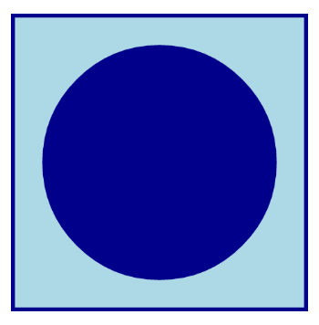
Using SVG in a web page
To use SVG you need to simply open the <svg> element and to start defining your shapes using XML notation
<svg width="300" height="450">
<rect x="50" y="50" width="150" height="150" fill="lightblue" />
<circle cx="125" cy="125" r="60" stroke="none" fill="darkblue" />
</svg>

Slide 8
Using SVG in a web page
To use SVG you need to simply open the <svg> element and to start defining your shapes using XML notation
<svg width="300" height="450">
<rect x="50" y="50" width="150" height="150" fill="lightblue" />
<circle cx="125" cy="125" r="60" stroke="none" fill="darkblue" />
</svg>
SVG uses a coordinate system for the sizes and positions

Slide 9
Simple SVG
Live Demo

Slide 10
SVG Shapes
What has SVG to offer?

Slide 11
SVG Shapes
As mentioned, vector graphics are built from graphic primitives
Points
Lines and curves
Shapes: rectangular, circle, etc…
SVG supports most of the basic shapes
More complex shapes can be created using the basic ones

Slide 12
SVG Shapes: Line
<line> is the most basic shape in SVG
Creates a line between two points
<line x1="0" y1="0"
x2="300" y2="450" stroke="black" />
<line x1="300" y1="0"
x2="0" y2="450" stroke="black" />
<line x1="0" y1="150"
x2="300" y2="150" stroke="black" />
<line x1="0" y1="300"
x2="300" y2="300" stroke="black" />
<line x1="0" y1="150"
x2="300" y2="300" stroke="black" />
<line x1="0" y1="300"
x2="300" y2="150" stroke="black" />

Slide 13
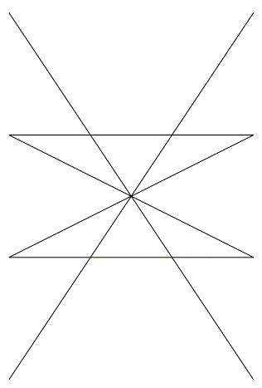
SVG Shapes: Line
<line> is the most basic shape in SVG
Creates a line between two points
<line x1="0" y1="0"
x2="300" y2="450" stroke="black" />
<line x1="300" y1="0"
x2="0" y2="450" stroke="black" />
<line x1="0" y1="150"
x2="300" y2="150" stroke="black" />
<line x1="0" y1="300"
x2="300" y2="300" stroke="black" />
<line x1="0" y1="150"
x2="300" y2="300" stroke="black" />
<line x1="0" y1="300"
x2="300" y2="150" stroke="black" />

Slide 14
SVG Shapes: Line
<line> is the most basic shape in SVG
Creates a line between two points
<line x1="0" y1="0"
x2="300" y2="450" stroke="black" />
<line x1="300" y1="0"
x2="0" y2="450" stroke="black" />
<line x1="0" y1="150"
x2="300" y2="150" stroke="black" />
<line x1="0" y1="300"
x2="300" y2="300" stroke="black" />
<line x1="0" y1="150"
x2="300" y2="300" stroke="black" />
<line x1="0" y1="300"
x2="300" y2="150" stroke="black" />
Stroke sets the color of the line

Slide 15
Defining Lines with SVG
Live Demo

Slide 16
SVG Shapes: Rects and Circles
<rect> creates a rectangular with a top-left position, width and height
<circle> creates a circle with center and radius
<rect x="10" y="10" width="280" height="280" fill="#222"/>
<circle cx="150" cy="150" r="135" fill="#333"/>
<rect x="55" y="55" width="190" height="190" fill="#444"/>
<circle cx="150" cy="150" r="95" fill="#555"/>
<rect x="85" y="85" width="130" height="130" fill="#666"/>
<circle cx="150" cy="150" r="65" fill="#777"/>
<rect x="105" y="105" width="90" height="90" fill="#888"/>
<circle cx="150" cy="150" r="45" fill="#999"/>

Slide 17
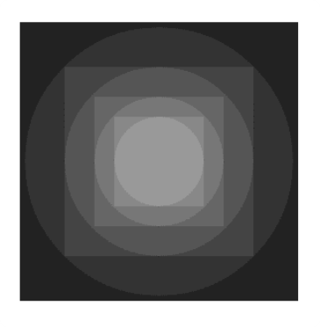
SVG Shapes: Rects and Circles
<rect> creates a rectangular with a top-left position, width and height
<circle> creates a circle with center and radius
<rect x="10" y="10" width="280" height="280" fill="#222"/>
<circle cx="150" cy="150" r="135" fill="#333"/>
<rect x="55" y="55" width="190" height="190" fill="#444"/>
<circle cx="150" cy="150" r="95" fill="#555"/>
<rect x="85" y="85" width="130" height="130" fill="#666"/>
<circle cx="150" cy="150" r="65" fill="#777"/>
<rect x="105" y="105" width="90" height="90" fill="#888"/>
<circle cx="150" cy="150" r="45" fill="#999"/>

Slide 18
Circles and Rectangles
Live Demo

Slide 19
SVG Paths

Slide 20
SVG Paths
SVG can define more complex shapes using the path
Create straight line from a point to other point
Create a curve between tw
o points
Used with the element <path>
Add giving commands and points for the lines using the "d" attribute

Slide 21
SVG Paths: Commands
The path commands are as follows:
M x y or m x y
Moves the path marker to position (x, y)
L x y or l x y
Creates a straight line between the marker point and point (x, y)
(H x or h x) and (V y or v y)
Creates a horizontal/vertical line from the marker point to the given point
Z or z
Closes the path, connects the first and last points

Slide 22
SVG Paths: Line Commands
Paths example
Drawing the letters "R" and "E"
<path stroke="yellowgreen" fill="none"
d="M 375 50 H 450 M 375 50 V 150 H 450 M 375 100 H 430" />
<path stroke="yellowgreen" fill="none" d="M 475 50 V 150 M 475 50 H 525 L 550 75 V 100 H 475 L 550 150" />

Slide 23
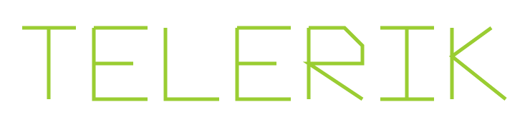
SVG Paths: Line Commands
Paths example
Drawing the letters "R" and "E"
<path stroke="yellowgreen" fill="none"
d="M 375 50 H 450 M 375 50 V 150 H 450 M 375 100 H 430" />
<path stroke="yellowgreen" fill="none" d="M 475 50 V 150 M 475 50 H 525 L 550 75 V 100 H 475 L 550 150" />

Slide 24
SVG Paths: Line Commands
Live Demo

Slide 25
SVG Paths: Curves
C x1 y1 x2 y2 x y
Cubic Bezier curve
Two control points: (x1, y1) and (x2, y2)
Ending point at (x, y)
S x2 y2 x y continues the curve
Q x1 y1 x y
Quadratic Bezier curve
One control point: (x1, y1)
Ending point at (x, y)
T x y continues the curve

Slide 26
SVG Paths: Curves Example

Slide 27
SVG Paths: Curves
Live Demo

Slide 28
SVG Paths: Arcs
Used to create arcs, i.e. sections of ellipses
A rx ry rotation large sweep x y
rx and ry define the radiuses at the X-axis and the Y-axis
roration defines the roration of the X-axis
TODO

Slide 29
SVG Paths: Arcs
Live Demo

Slide 30
SVG Animations

Slide 31
Simple Animations
Simple animations can be performed by adding <animate> tag with some additional properties.
<circle cx="200" cy="200" r="100" fill="red">
<animate attributeName="fill" to="blue" dur=".4s" repeatCount="indefinite" />
</circle>
<rect width="50" height="50" x="600" fill="red">
<animate attributeName="y" from="-50" to="600" dur="5s" repeatCount="indefinite" />
</rect>
<ellipse cx="200" cy="400" rx="50" ry="75" fill="purple">
<animate attributeName="rx" to="75" dur="4s" repeatCount="indefinite" />
</ellipse>

Slide 32
Animations Demo
Live Demo

Slide 33
SVG Scripting
Using SVG with JavaScript

Slide 34
SVG Scripting
Live Demo

Slide 35
SVG
http://academy.telerik.com

